Slide 1



Slide 2



 | Slope Bins 4 | Smear Count 25
Block number | Alpha w/ Henderson Hasselbalch | Chi Chi_max = 2.2
[0 50] | 0.040012 | 1.160000
[50 75] | -0.278451 | 0.720000
[75 125] | -0.519707 | 0.608000
[125 156] | -0.154453 | 0.529032

Slide 3


 | Slope Bins 4 | Smear Count 31
Block number | Alpha w/ Henderson Hasselbalch | Chi Chi_max = 2.2
[0 31] | 0.001103 | 0.922581
[31 62] | -0.386873 | 0.703226
[62 93] | -0.290146 | 0.967742
[93 496] | 0.037164 | 1.098759
[496 527] | -0.064533 | 0.819355
[527 620] | 0.010682 | 0.756989
[620 647] | -0.103326 | 0.696296

Slide 4
Binary results

Slide 5







For i as L and H:
Pure height profiles
Mixed height profiles
Current L library
Current H library
Skip; marginal increase in vol prob not enough
Move onto chi3.0; larger NFL vol library

Slide 6





All plotting wrong L pure; look only at purp
NFL
NFH
H volume too low to neutralize L (v = 31 nm3/c)

Slide 7







H volume v = 60 nm3/c

Slide 8







H volume too low to neutralize L

Slide 9








NFH, V = 70

Slide 10



NFH & NFL v = 0.15

Slide 11

Based on NFH v15, apply VL = VH

Slide 12
L/H Fitting

Slide 13






Try b change, v same as H (0.15)
Phi unrealistic (?)
Phi unrealistic
Phi very unrealistic
Phi very unrealistic

Slide 14






Try similar params to H
5.6
11.2
16.8
28
56
7.5
11.25
18.75

Slide 15


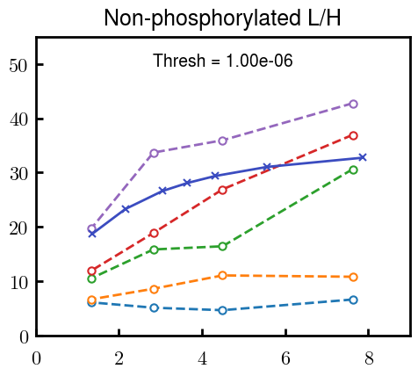
Try similar params to H, b change
7.8
15.6
23.4
31.2
Unrealistic vol

Slide 16


Continuation from prev params

Slide 17







v2.7 and some fine
b1.50 v2.7 c3.2
b1.75 v2.7 c3.2
b1.75 v2.5 c3.2
b1.75 v2.5 c3.0
b2.0 v2.7 c3.2
b2.25 v2.7 c3.2
b2.50 v2.7 c3.2
Phi too small to decrease v0

Slide 18










b2.0 v10.0 c3.0
b2.0 v8.0 c3.0
b2.0 v6.0 c3.0
b2.0 v4.0 c3.0
b2.0 v2.0 c3.0
Phi limit
b1.8 v10.0 c3.0
b1.8 v8.0 c3.0
b1.8 v6.0 c3.0
b1.8 v3.0 c3.0
b1.8 v2.0 c3.0
Phi limit

Slide 19





b1.6 v10.0 c3.0
b1.6 v8.0 c3.0
b1.6 v6.0 c3.0
b1.6 v2.0 c3.0
b1.6 v1.5 c3.0
Phi limit

Slide 20


Response to stimuli given composition
Same data
Effect of composition given environment

Slide 21


NFL, pH 7.44, phos 1.5e (locs from LCMS)
Non-phos NFL
Block number | Alpha w/ Henderson Hasselbalch | Chi Chi_max = 3.2
[0 50] | 0.040012 | 1.540000
[50 75] | -0.278451 | 0.960000
[75 125] | -0.519707 | 0.868000
[125 156] | -0.154453 | 0.690323
 | Slope Bins 4 | Smear Count 25
Block number | Alpha w/ Henderson Hasselbalch | Chi Chi_max = 3.2
[0 50] | -0.019988 | 1.540000
[50 75] | -0.278451 | 0.960000
[75 125] | -0.519707 | 0.868000
[125 156] | -0.154453 | 0.690323

Slide 22


NFH, pH 7.44, phos 1.5e (locs from LCMS)
 | Slope Bins 4 | Smear Count 36
Block number | Alpha w/ Henderson Hasselbalch | Chi Chi_max = 3.2 | Chi Chi_max = 3.0
[0 36] | 0.000945 | 1.266667 | 1.20000
[36 72] | -0.527455 | 0.900000 | 0.85000
[72 324] | -0.208376 | 1.729365 | 1.628571
[324 396] | -0.111195 | 1.416667 | 1.333333
[396 432] | -0.152824 | 1.344444 | 1.266667
[432 647] | -0.033955 | 1.077209 | 1.015814

Slide 23

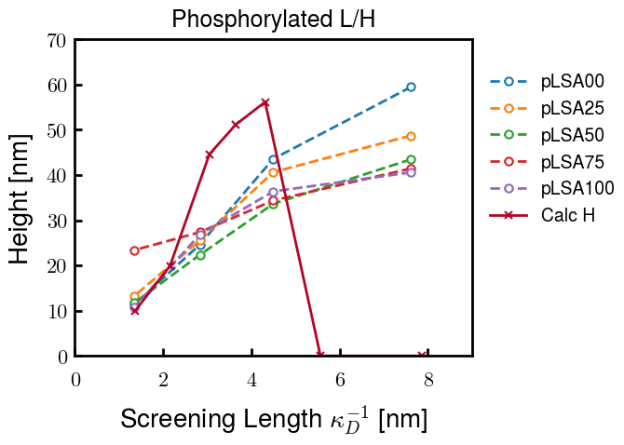
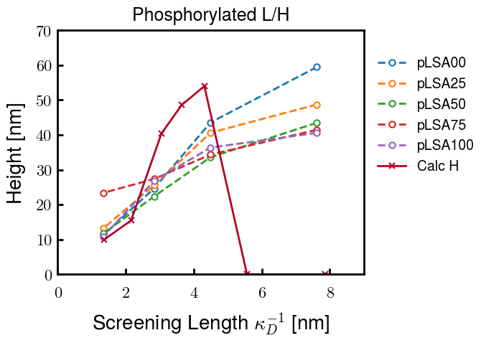
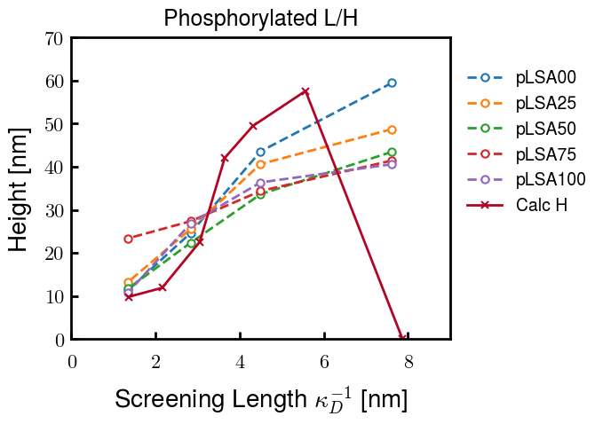
Instead of fitting b/v, could just change value of charge on phos. Try both and see if makes difference for mixture

Slide 24









b2.0 v2.7 c3.2
b3.0 v3.5 c3.5
b3.0 v7.0 c3.5
b3.0 v7.0 c3.0
Phi too small
Phi too small to decrease v0
b4.0 v12.0 c3.0
b5.0 v20.0 c3.0
b5.0 v20.0 c4.0
b5.0 v5.0 c3.0
b5.0 v10.0 c3.0
Phi too small to decrease v0

Slide 25





v20
b5.0 v20.0 c3.0
b4.5 v20.0 c3.0
b4.0 v20.0 c3.0
b3.5 v20.0 c3.0
v10
b5.0 v10.0 c3.0
b4.0 v10.0 c3.0
b3.0 v10.0 c3.0
b2.0 v10.0 c3.0

Slide 26




b2.00 v2.70 c3.20
b2.00 v2.75 c3.20

Slide 27
NFH fitting (from NFL best fit)

Slide 28








b1.00, v0.50, c3.2
b2.00, v4.00, c3.2, th2.5e-02
b1.00, v2.00, c3.2
b1.00, v1.00, c3.2

Slide 29
Mixture

Slide 30



Slide 31


b = 0.75

Slide 32





Slide 33
b = 1.0

Slide 34





Slide 35
b = 1.25

Slide 36




Chi 2.6
Bad vol frac

Slide 37








b25v0
b25v1
b25v2
b25v3

Slide 38




Chi 2.8
Bad vol frac

Slide 39





Slide 40
b = 1.50

Slide 41






Chi 2.8
Bad vol frac

Slide 42





Slide 43

b = 2.00
v4 = 0.25*b^3

Slide 44


Bad vol frac

Slide 45



Slide 46
Fine tune

Slide 47



b1.25, v1.95, c3.0
b1.50, v3.38, c3.0
b2.00, v4.00, c3.0
Norm seems to capture kinked behavior

Slide 48




Slide 49



b1.25, v1.95, c3.2
b1.50, v3.38, c3.2
b2.00, v4.00, c3.2

Slide 50




Slide 51


b1.25
b1.50
b2.00
c2.8
c3.0
c3.2

